Slide 1



Slide 2




Slide 4































Slide 5



























file.log

Slide 6

file.log

Slide 7
















Slide 8




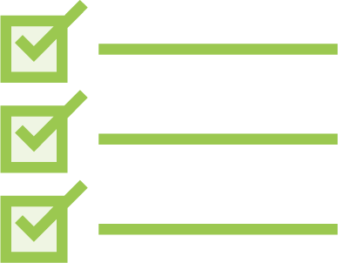












Slide 9




Slide 10


















Slide 11
Path dir = Paths.get("D:/logs");
FileSystem fileSystem = dir.getFileSystem();
WatchService watchService = fileSystem.newWatchService();

Slide 12
WatchKey key = dir.register(watchService,
StandardWatchEventKinds.ENTRY_CREATE, StandardWatchEventKinds.ENTRY_DELETE, StandardWatchEventKinds.ENTRY_MODIFY);

Slide 13




















Slide 14
while (key.isValid()) {
// or poll with / without a timeout
WatchKey take = watchService.take();
List<WatchEvent<?>> events = take.pollEvents();
// work with the events take.reset();
}

Slide 15








Slide 16






for (WatchEvent<?> event : events) { WatchEvent.Kind<?> kind = event.kind();
if (kind == StandardWatchEventKinds.OVERFLOW) { // overflow
continue;
}
// operations on the elements
}

Slide 17




Slide 18





Slide 19






Slide 20



Slide 21


